Slide 1
Source Control

Slide 2
Source Control
centralise all code changes and additions to one code repository
allow for simple and effective collaboration within development teams
control the integration of new code into the codebase
track changes from the entire team over the full lifetime of the project
revert code back to previous versions

Slide 3
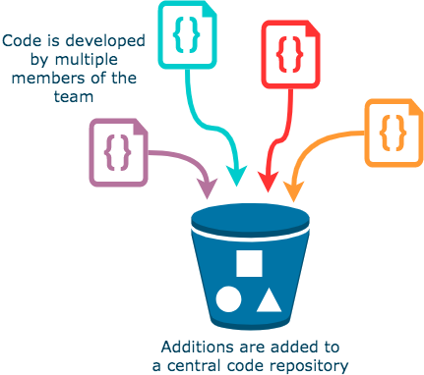
Source Control Management
Store code in a central repository
Track changes over time
Create code branches so that additions are made in isolation from stable code
Merge new code into a stable release branch, known as the master branch
Integrate with CI/CD automation tools (such as Jenkins and CircleCI) such that code will be built and tested as it is generated and pushed to the repository

Slide 4
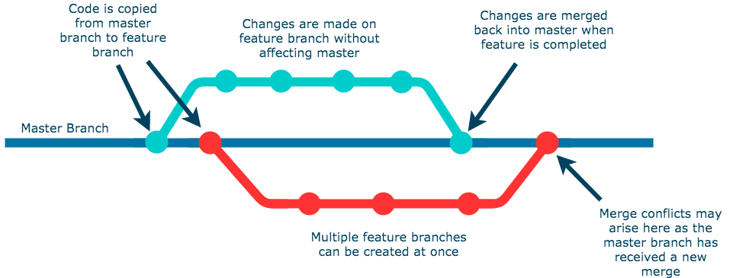
Branching
Several people working on the same code base causes problems
Feature branch model

Slide 5
Code Tracking
allows development teams to keep track of all changes made to a project over time
makes it easy to revert

Slide 6
SCM Tools
Git
Mercurial
Subversion (often abbreviated to SVN)
CVS
Perforce

Slide 7
Repository Hosting Services
GitHub
GitLab
Bitbucket
SourceForge
Launchpad
AWS CodeCommit
Azure Repos (as part of Azure DevOps)
Google Cloud Source Repositories

